Slide 1
Pathology of liver infections
Prof. J. Hewavisenthi
Department of Pathology
Faculty of Medicine
University of Kelaniya

Slide 2
Liver - Structure
Liver lobule is the microscopic and functional unit.
  Hexagonal
  1-2 mm diameter
  Cords of anastamosing and branching polygonal cells disposed radially about a central vein.

Slide 3
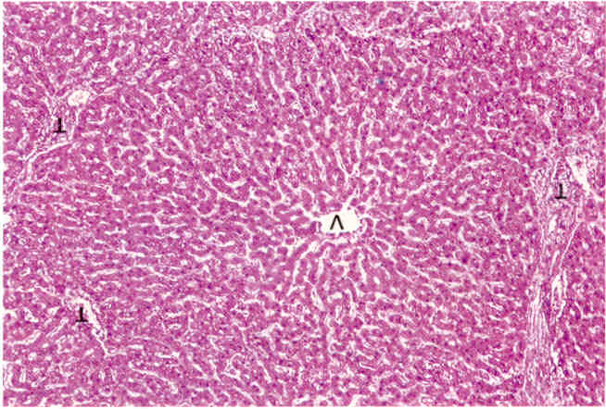
Liver lobule

Slide 4
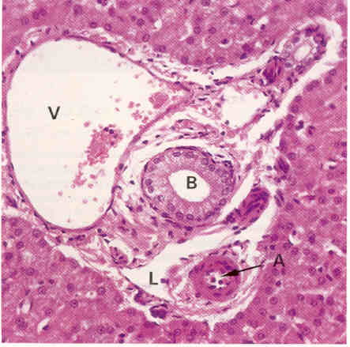
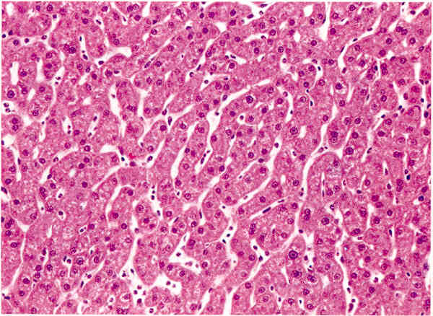
Portal tract
Hepatocytes

Slide 5
Liver - Structure
Limiting plate - cells surrounding the portal tracts
Sinusoids - in between cords of hepatocytes. Endothelial lining Kupffer cells.
Space of Disse - Between sinusoids and liver cell cords, contain lipocytes (ItO cells)

Slide 6
Liver lobule
CLASSICAL LOBULE
CENTRILOBULAR
INTERMEDIATE
PERIPORTAL
RAPPORTS ACINUS
ZONE 3
ZONE 2
ZONE 1

Slide 7
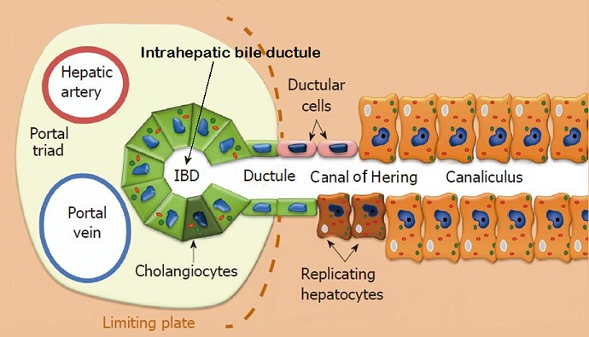
Intrahepatic biliary system

Slide 8
Infections of the liver
Hepatotrophic viruses
  Hepatitis A, B, C, D, E, F and G
Other viruses
  EBV
  CMV
  HIV
Entamoeba histolytica
Pyogenic liver abscess
Fungal organisms

Slide 9
Infections of the liver – Clinicopathological syndromes
Acute hepatitis
Fulminant hepatitis / Bridging / Confluent necrosis
Chronic hepatitis
Cirrhosis
Hepatocellular carcinoma
Other pathology
  Cholestasis
  Steatosis
  Bile duct lesions
  Granuloma formation (Granulomatous hepatitis) - HCV

Slide 10
Acute Hepatitis- clinical features
Fever
RHC pain
Jaundice
Loss of appetite
Vomiting
Passing of dark coloured urine

Slide 11
Acute hepatitis – pathological features
Hepatocellular damage ) Defining features
Inflammatory cell infiltrate )
Other changes (varying degrees)
  Cholestasis
  Kupffer cell activation
  Siderosis
  Endotheliitis
  Bile ductular proliferation & damage
  Hepatocellular regeneration

Slide 12
Acute Hepatitis - Morphology
Diffuse liver cell injury and lobular disarray.
Hypertrophy and hyperplasia or kupffer cells and sinusoidal lining cells.
Portal inflammation – lymphocytes and macrophages.
Hepatocyte regeneration – bi and trinucleate cells.

Slide 13
Hepatocellular damage
Cell swelling – Ballooning degeneration
Apoptosis
Focal spotty necrosis
The above cell changes lead to the characteristic irregularity of cell plates = LOBULAR DISARRAY (condensation of reticulin)
Rarely syncitial cells / giant cell formation may be seen.

Slide 14
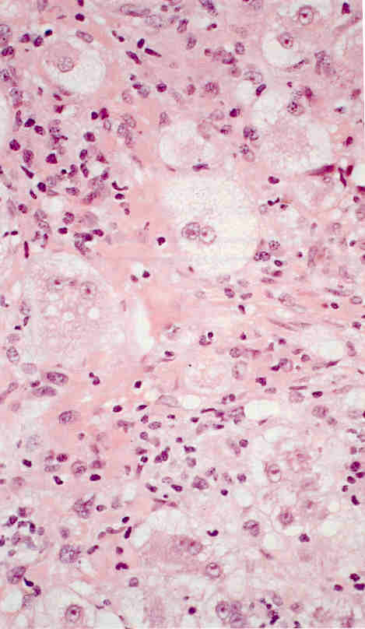
Diffuse liver cell injury
Ballooning degeneration due to hydropic degeneration of ER.

Slide 15
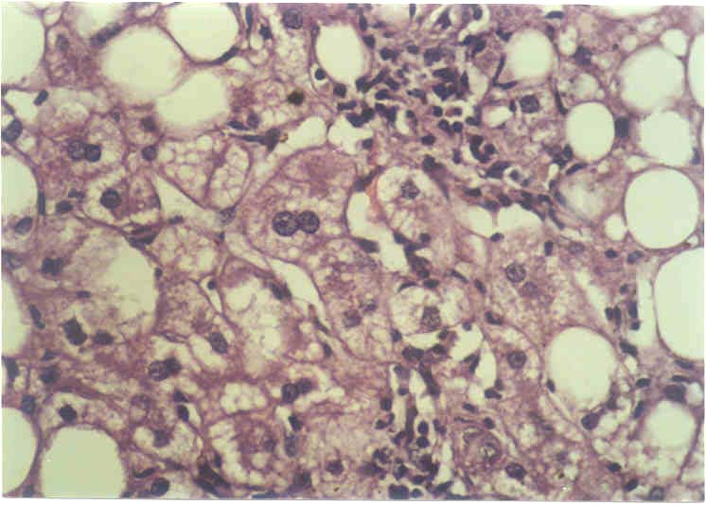
Ballooning degeneration

Slide 16
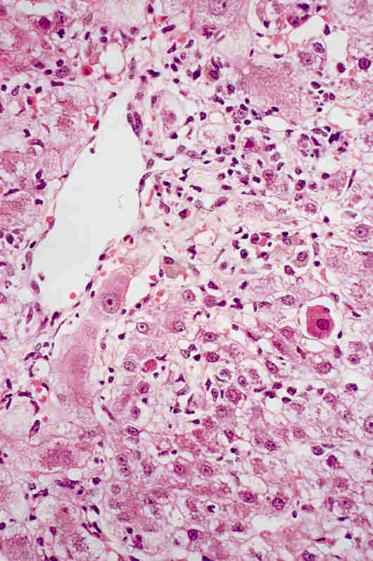
LIVER CELL NECROSIS
Formation of Councilman bodies – Apoptotic bodies
Eosinophilic refractile bodies.
Distinctive of Acute Hepatitis.
Form of Apoptosis.

Slide 17
Lobular disarray
Cellular swelling necrosis and regeneration producing vascular compression and loss of the radial arrangement of hepatocytes.

Slide 18
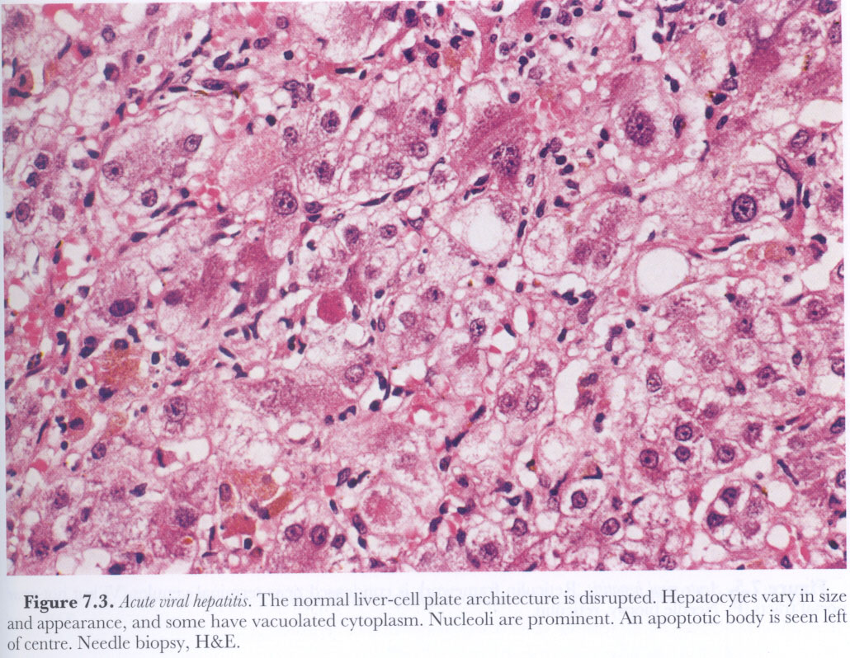

Slide 19
Inflammatory cell infiltrate
Mainly in zone 3
Extent of portal inflammation is variable.
  Expanded or normal
  Normally the portal – parenchymal interface is sharp but occasionally inflammatory cell spill over is seen (DD- interface hepatitis*)
Type of cell
  Predominant cell is the lymphocyte (unlike acute inflammation)
  Eosinophils and plasma cells may be present
  (DD – Drugs and AIH)

Slide 20
Acute hepatitis – other pathological features
Portal tract changes are mild. Therefore acinar changes predominate over portal changes
Cholestasis – associated with inflammation and lobular disarray
Sinusoidal venular endothelial swelling
Kupffer cell hyperplasia

Slide 21
Acute hepatitis picture
Viral – mainly Hepatitis A and E
  Less commonly – Hepatitis B
Drugs
Bile duct obstruction
Autoimmune hepatitis
Alcoholic hepatitis

Slide 22
Acute hepatitis – histological variations
Confluent necrosis – substantial areas of the parenchyma undergoing necrosis
Bridging necrosis – Confluent necrosis linking terminal venules to portal tracts – necrosis of entire zone 3

Slide 23
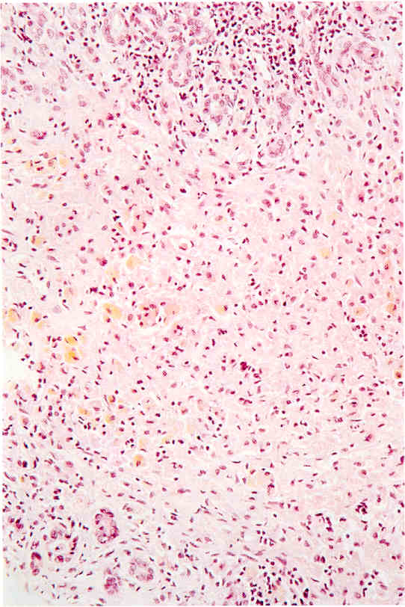
Confluent necrosis

Slide 24
Fulminant hepatitis – massive necrosis
Pan acinar necrosis when confluent necrosis extends through an entire acinus
Multi acinar necrosis when confluent necrosis involves more than one adjacent acinus – fulminant hepatitis
Liver biopsy in these situation may not be useful (definitely harmful ) because these changes are focal.

Slide 25
Fulminant Hepatitis
Aetiology - Drugs and chemicals Viral - HBV + HDV
Massive - When hepatic insufficiency progresses from onset - death within 2 - 3 weeks.
Submassive - A less rapid course extending upto to 3 months.

Slide 26
Causes of fulminant Hepatitis
Viral Hepatitis.
Drug induced Hepatitis.
Poisoning
Ischaemia
Obstruction to Hepatic veins.
Wilsons disease.
Autoimmune hepatitis.
Fatty liver of Pregnancy.
Partial hepatectomy.

Slide 27
Morphology
Macroscopy –
  Liver shrunken and blotchy with green staining and a large capsule.
  Depressed areas of necrosis.
  Cut surface - red and mushy.
Microscopy
  Entire lobule necrosed.
  Reticulin framework collapsed
  PT closer together

Slide 28
Different histological patterns in types of Viral hepatitis
Type A
  Perivenular cholestasis with little liver cell damage or inflammation
  Hepatitis with periportal necrosis and a dense portal infiltrate with abundance of plasma cells.
  Chronic course is very rare.
Type B
  Overlap with features of chronic disease
  Ground glass hepatocytes

Slide 29
Different histological patterns in types of Viral hepatitis
Hepatitis C
  Prominent sinusoidal lymphocyte infiltration in the absence of liver cell damage *
  Other features of chronic HCV disease
  Fulminant hepatitis is rare
Hepatitis D
  Finely granular eosinophilic nuclei – Sanded nuclei
  Extensive hepatocellular damage when associated with HBV
Hepatitis E
  Very little information but indistinguishable from HAV

Slide 30
Other infections of the liver
Other viral infections
  Viral haemorrhagic fevers – hepatic necrosis especially midzonal (Typically in yellow fever)
  HSV and adenovirus – irregular areas of necrosis
  Paramyxovirus – Giant cell / syncytial hepatitis
  CMV – characteristic inclusions, bile duct damage
  Infectious mononucleosis – Sinusoidal aggregates of lymphocytes and atypical lymphoid cells in the portal tracts.

Slide 31
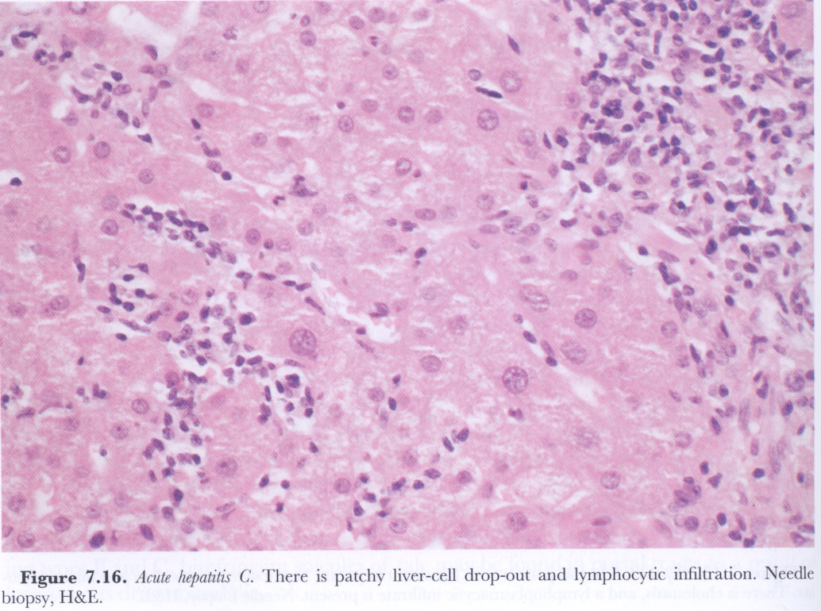
Sinusoidal aggregates of lymphocytes

Slide 32
Granulomatous hepatitis
Tuberculosis
Fungal
Schistosomiasis
Q fever
Chronic granulomatous disease of childhood
Cat scratch disease
Tularaemia
Yersinia
CMV
Hepatitis C
Other non infective causes
  Primary biliary cirrhosis
  Drugs
  Sarcoidosis

Slide 33
Infections of the Liver
Non suppurative - Typhoid fever, Brucellosis, Leptospirosis.
Tuberculosis - Granulomata.
Suppurative - PYOGENIC LIVER ABSCESS

Slide 34
Liver abscess
Parasitic - Amoebae, Echinococcus.
Bacterial - E coli, Pseudomonas, Klebsiella, Enterobacter, Group D Strept. Anaerobes.
Fungal - Candida (immunocompromised)

Slide 35
Liver abscess - pathogenesis
Portal veins - appendicitis, cholecystitis, diverticulitis, colitis and other forms of GI sepsis.
Arterial - from infective focus elsewhere.
Ascending infection via the billiary tract.
Direct invasion from nearby focus.
Penetrating injury.
Cryptogenic.

Slide 36
Amoebic liver abscess
Clinical - fever, pain, Hepatomegaly.
Macro - large cavity line by irregular shaggy walls. With reddish brown pus (Anchovy paste)
Micro - multiple small abscess coalesce to form larger abscess. Not a true abscess because there are very few neutrophils.

Slide 37
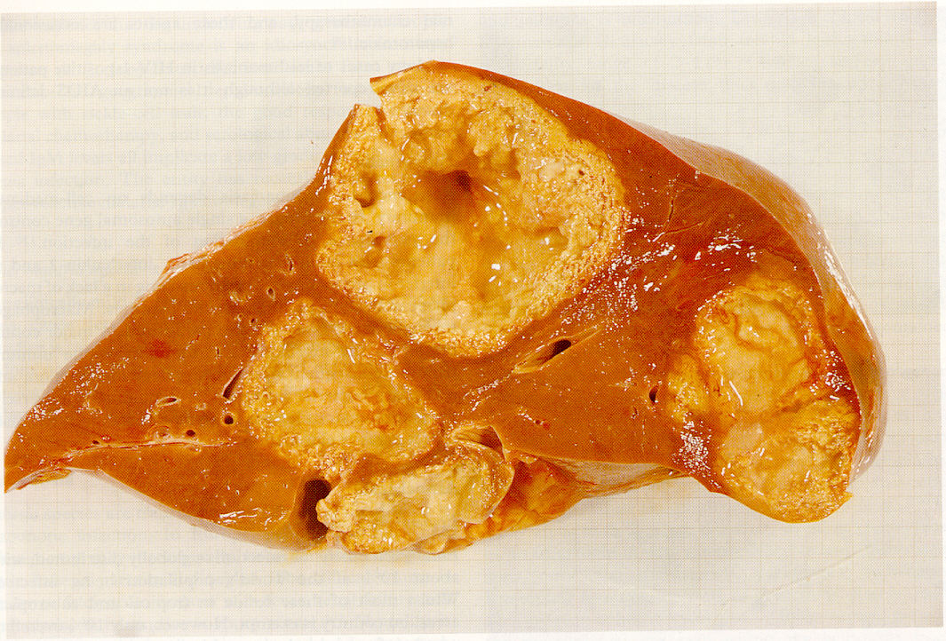

Slide 38
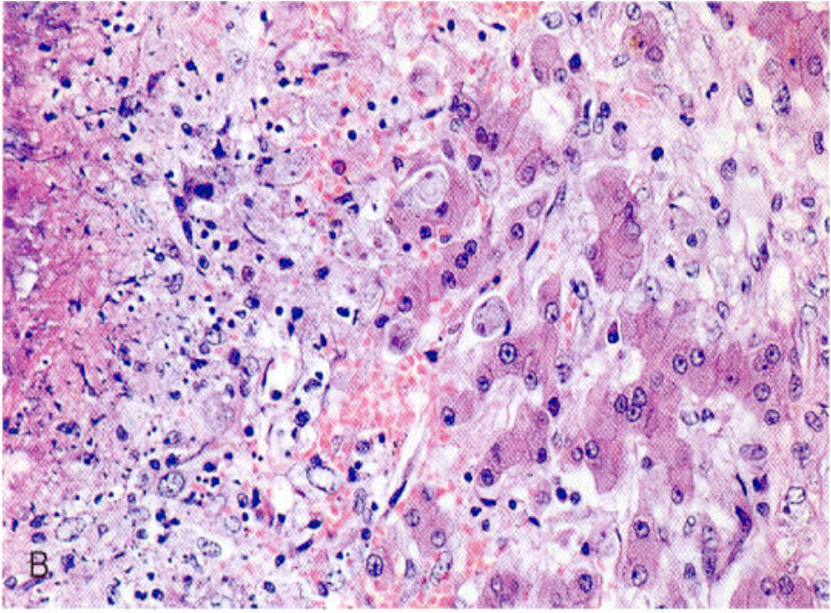

Slide 39
Amoebic liver abscess- Investigations
CXR
USS
Serum for amoebic antibodies.
Aspirate for trophozoites
LFT - Serum alkaline phosphatase.

Slide 40
Chronic liver disease

Slide 41
Chronic liver diseases
Chronic hepatitis
Hepatitis B,C, D
Drugs
Autoimmune hepatitis
Idiopathic
Cirrhosis
Fatty liver diseases
Alcoholic liver disease
Non alcoholic fatty liver disease

Slide 42
Chronic hepatitis
Persistence of liver injury associated with either elevated aminotransferase levels or viral markers for greater than 6 months.
6 months is a artificial time limit.
  Acute hepatitis can be prolonged
  Chronic liver diseases can develop insidiously
Strictly speaking should include all liver disease with an inflammatory component.

Slide 43
Conditions sharing pathological features with the classical forms of chronic liver disease
Wilsons disease
Alpha 1 antitrypsin deficiency
Primary billiary cirrhosis
Sclerosing cholangitis
Classical forms - see previous slide
Current nomenclature is based on aetiology*

Slide 44
Histological features
Portal inflammation – mild +/- expansion (CPH) – severe with expansion
Parenchymal changes
  Periportal lesions – interface hepatitis / piece meal necrosis
  Intra acinar changes – focal / spotty necrosis, confluent necrosis / bridging and hepatitic rosettes (hepatocytes trapped within inflammatory cell infiltrate)

Slide 45
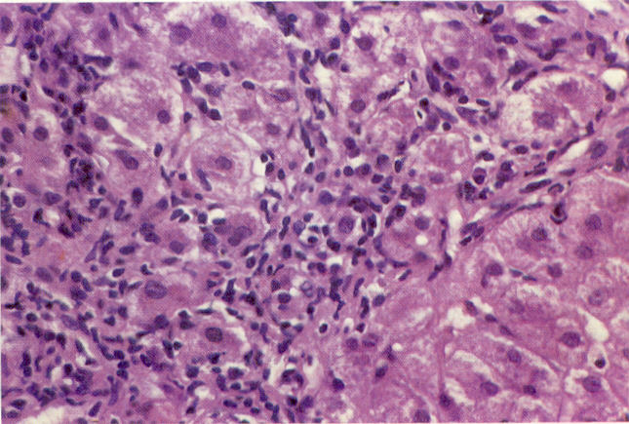
Interface hepatitis – DD inflammatory cell spill over

Slide 46
Hepatitis B
Ground glass hepatocytes – mainly due to abundance of ER and HBV surface material
Sanded nuclei – eosinophilic appearance of the nucleus due to abundance of core particles

Slide 47
Hepatitis C – histological features
Difficult to distinguish from acute hepatitis
Often mild but cirrhosis develops
Lymphoid follicles in the portal tracts
Damaged interlobular bile ducts
Acinar activity including apoptotic bodies
Large droplet steatosis
Lymphocytic infiltration of the sinusoids
Granulomas
Mallory body formation

Slide 48
Chronic hepatitis.
Chronic persistent
CHRONIC HEPATITIS Chronic active

Slide 49
Grading and staging in Chronic Hepatitis
Grading - the degree of necroinflammatory activity present.
Staging - the amount of fibrosis.

Slide 50
Grading systems (Histological activity index - HAI)
Portal inflammation
Interface hepatitis / Piecemeal necrosis
Lobular inflammation
Bridging necrosis.

Slide 51
Histological Phenotypes
Minimal hepatitis
Chronic persistent hepatitis.
Chronic lobular hepatitis
Chronic active hepatitis
  CAH - minimal
  CAH - mild
  CAH - moderate
  CAH - Severe
  CAH - Very severe

Slide 52
Chronic persistent hepatitis.
Benign smouldering infection persisting for many years without seriously impairing hepatic function.
Clinical –
  Fatigue, malaise, LOA, Jaundice
  Serum Transaminases increased.
Microscopy – Portal tract expansion by an inflammatory infiltrate.

Slide 53
Chronic active Hepatitis
Diseases with features of Chronic active Hepatitis
Differential diagnosis -
  1. Wilson’s disease.
  2. Alpha - 1 antitrypsin deficiency.
  3. Alcohol.

Slide 54
Cirrhosis

Slide 55
Definition
Condition involving the entire liver in which the parenchyma is changed into a large number of nodules separated from one another by irregular branching and anastamosing fibrous septae.

Slide 56
Characteristics
Architecture of the entire liver disorganized.
Fibrous bands / septa -
  Portal – Portal
  Portal - Central
  Both.
Parenchymal nodules
Vascular architecture reorganized by parenchymal damage and scarring. - Arterio - venous anastamosis.

Slide 57
Classification
Morphological
  Macronodular - > 3 mm diameter nodules.
  Micronodular - < 3 mm diameter nodules.

Slide 58
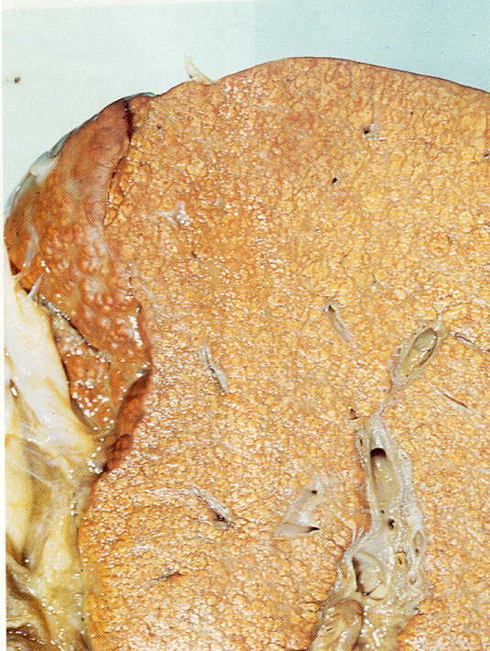
Micronodular cirrhosis

Slide 59
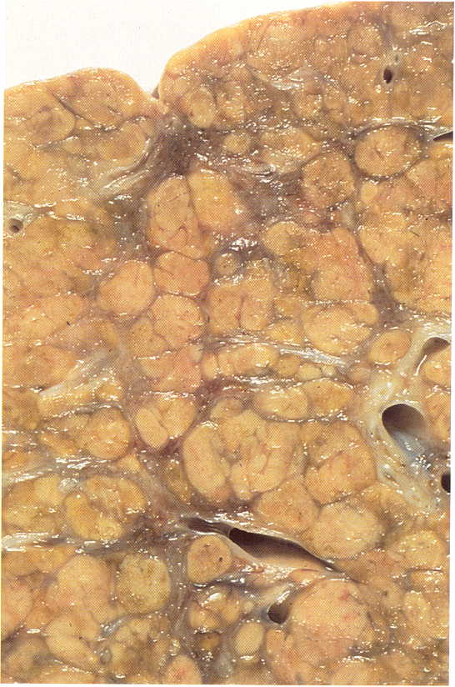
Macronodular cirrhosis

Slide 60
Classification - Aetiological
1.Alcoholic cirrhosis - 60 - 70%
2. Post viral (necrotic) cirrhosis - 10 %
3. Billiary cirrhosis - Primary and Secondary - 5 - 10 %
CRYPTOGENIC

Slide 61
Heriditary / Childhood cirrhosis contd.
  Pigment cirrhosis (Haemachromatosis)
  Wilson’s disease
  Alpha 1 antitrypsin deficiency,
Less common
  Galactosaemia.
  Type 1V Glycogen storage disease.
  Tyrosinosis
  Fructose intolerance.
  Indian childhood cirrhosis.

Slide 62
Pathogenesis
Liver cell Injury
+
Host Factors
Alcohol , Viral etc
Progressive Hepatocyte Injury
Chronic inflammation
Liver cell regeneration
Fibrosis
Hyperplastic nodules
Ischaemia
Cirrhosis

Slide 63
Pathological features
Macroscopy
  Size Enlarged ( fatty change and regeneration) Smaller (shrinkage due to loss of cells) Normal size

Slide 64
Pathological features
Surface - diffusely nodular.
Cut surface - nodules separated by fibrous septa.
Colour
  Pale - Fatty change
  Bile stained - Cholestasis
  Red - congestion.

Slide 65
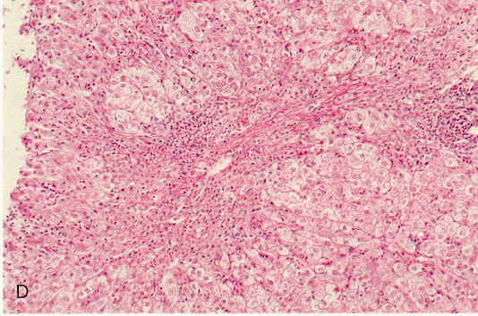
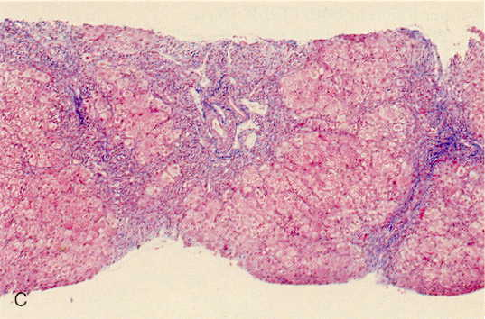
Microscopy

Slide 66
Post- viral cirrhosis
Younger age group.
Macronodular cirrhosis.
Liver smaller than in alcoholic cirrhosis.
Microscopy - normal architecture in some nodules. Interface hepatitis & lymphocytic infiltrate denoting infective process.
Prognosis - poorer than in the alcoholic type

Slide 67
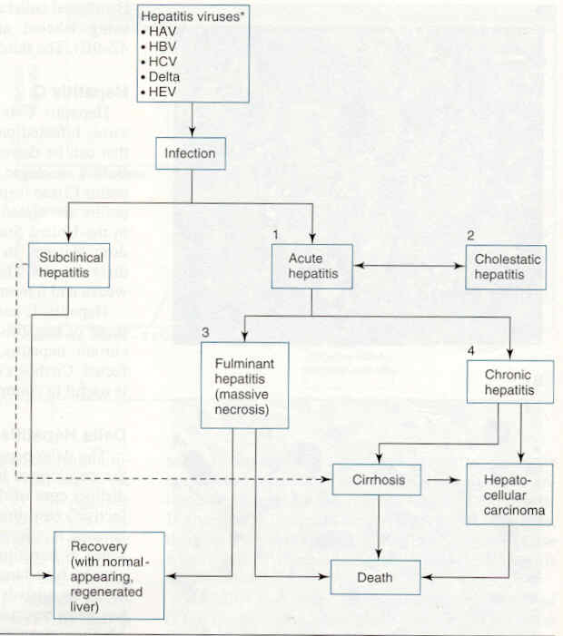

Slide 68
Assignment
List the histological feature that may be seen in a liver biopsy and list the possible causes for each
  Intra acinar / lobular inflammation
  Interphase hepatitis / piece meal necrosis
  Bile duct lesions
  Sinusoidal lymphocytosis
  Mallory body formation
  Steatosis of hepatocytes
  Cholestasis
  Pigment deposition
  Fibrosis

